Slide 1











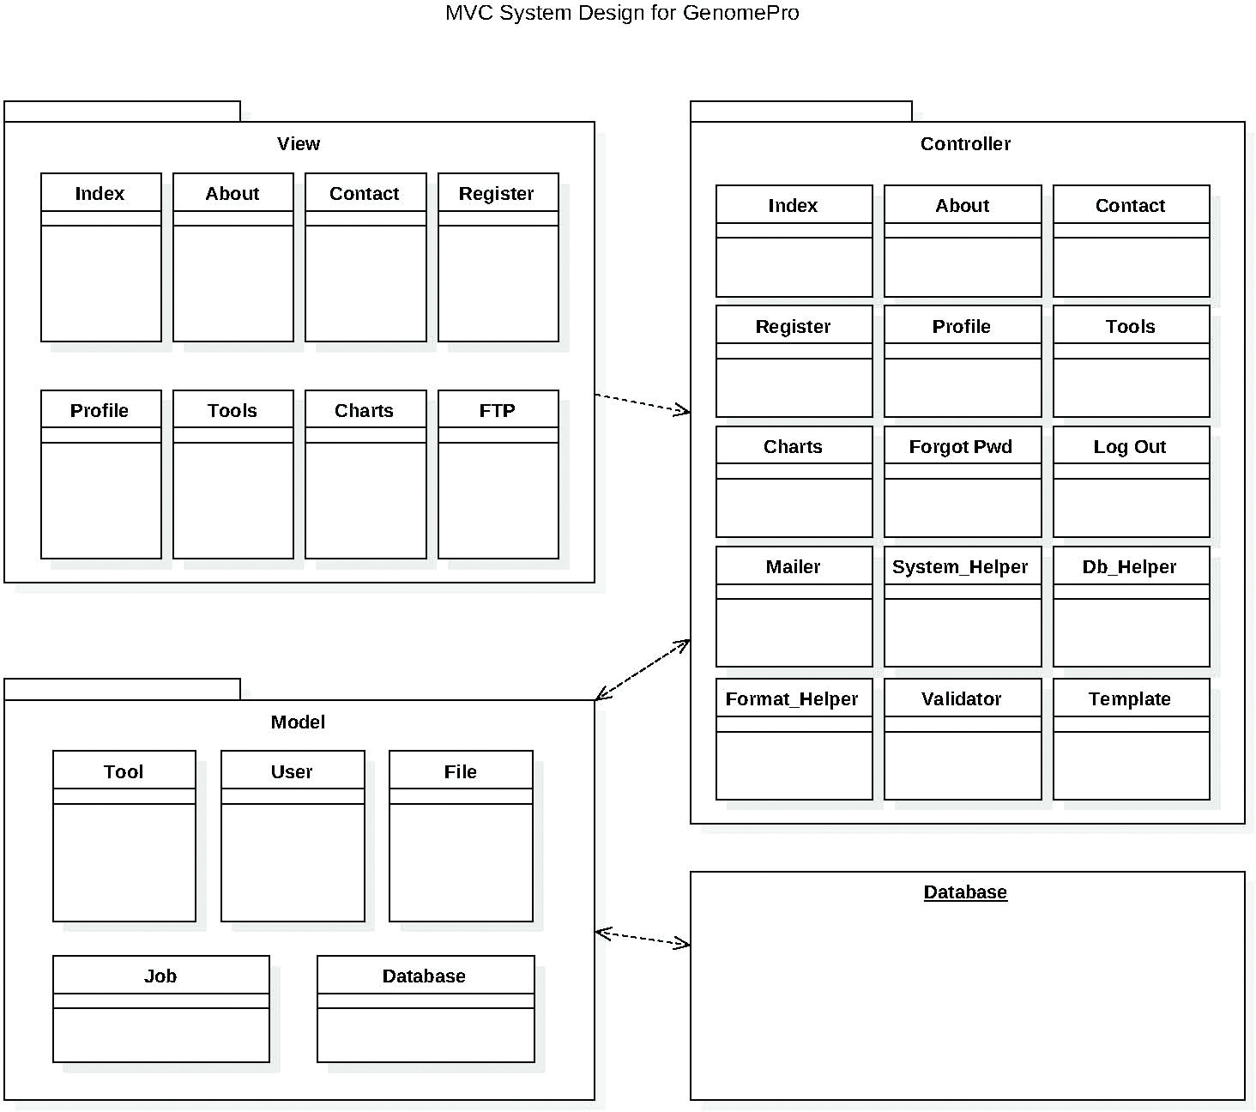

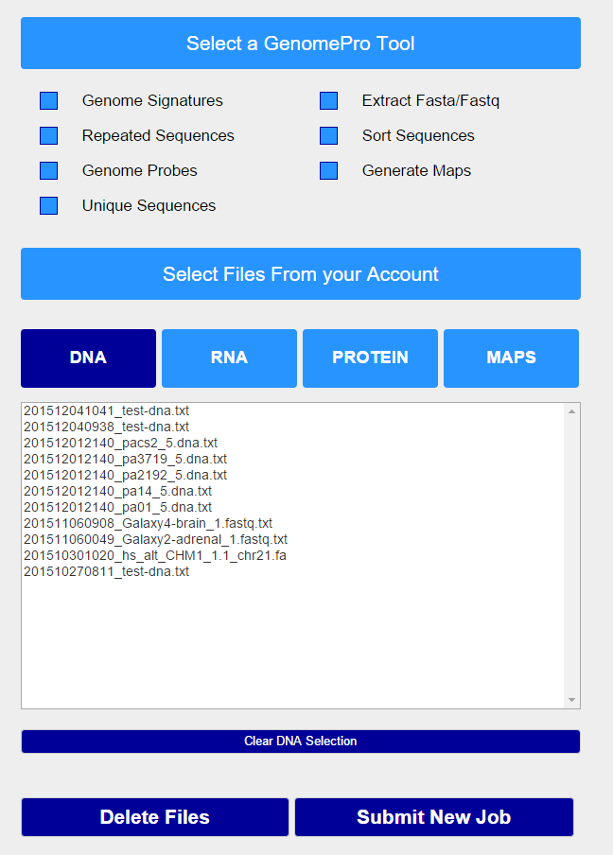
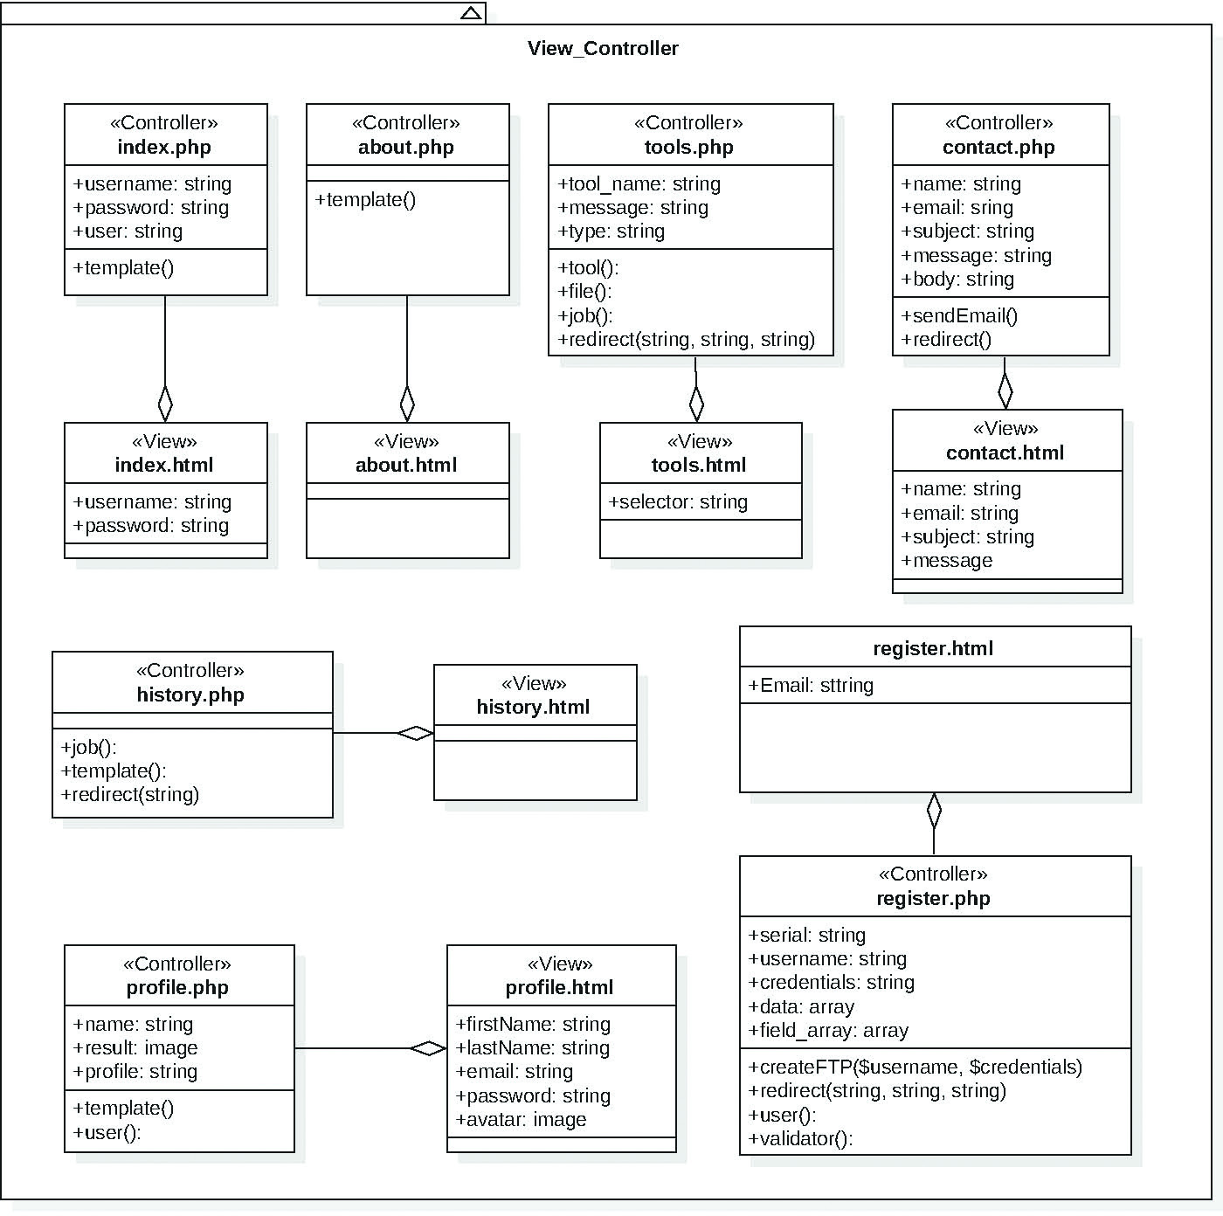
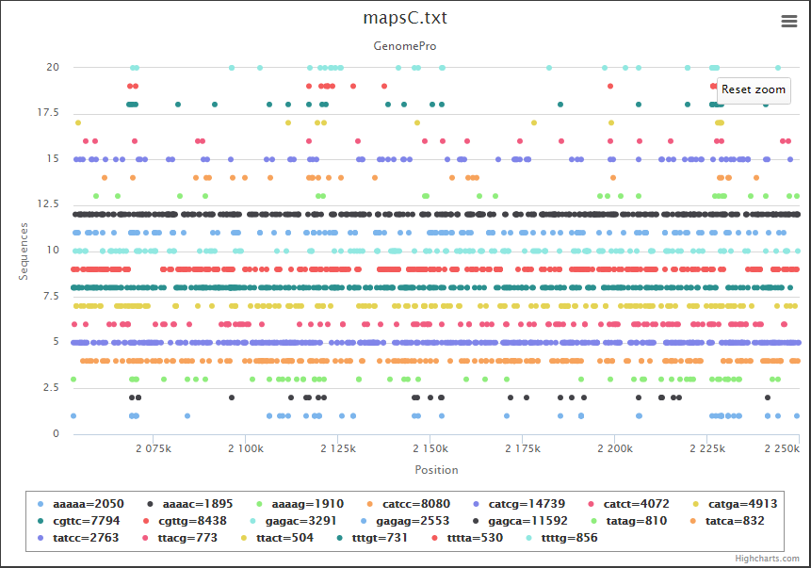
School of Computing & Information Sciences
GenomePro 2.0
Senior Project 2015, Fall
Student: Mardoqueu Mesquita, Florida International University
Mentor: Michael Robinson, Florida International University
Instructor: Masoud Sadjadi, Florida International University
Problem
Current System
Requirements
Genomic Data Processing: Genes scatter through the human genome like stars in the universe; yet, with genomic material representing light-years of noncoding DNA – The Dark Matter.
Gene hunters who mine wonders from the human genome need more powerful tools
and more ambitious strategies.
Genome files can be extensively large therefore there is a need for specific tools and methods for cleaning up those files and for sequence processing that can lead to the predictions of undiscovered genes.
The application of computational methods to genomic data science is an ever growing and exciting development in both biological and medical fields of study.
GenomePro 1.0 successfully launched Michael Robinson’s idea to deliver more powerful tools and more ambitious strategies to aid medical professionals as well as biologists.
This second version of GenomePro creates a web application that is able to automate and accelerate the task of processing Gigabytes of genomic data files.
The system must keep functionalities from GenomePro 1.0 and add the following:
Genome Data Types (File Validator)
Genome Signatures
Unique Sequences
Genome Probes
Extract and Sort Sequences
Generate Maps from sorted sequences and create its graphical representation for better visual analysis
Redesign web interface
System Design
Screenshots
Implementation
MVC
How To Register At Genome Pro
GenomePro 2.0 offers the speed of the ANSI C language and its Standard Library functions
to deliver powerful performance for processing large volumes of genomic data.
The web site was implemented using HTML and CSS organized with JavaScript as the common client-side scripting language to handle user interactions within the pages.
The backend implementation required PHP
for the server-side scripting language, which was successfully completed by Guido Ruiz.
Home Page
Verification
GenomePro Tools Web Interface
The Testing Life Cycle
Report Diagnostics, Metrics and Compliance
Verify Database, Performance and Interfaces
Plan Input Data, Processes and Expectations
Object Design
Class Diagram
Automation: Selenium IDE
Visualize Graphics for repeated sequences
Summary
Their Location and how clustered their appear next to other sequences providing better genes predictions and analysis.
GenomePro 2.0 presents a new web development to convey a well-structured programming framework designed to ease the advance of efficient and robust analysis tools for next generations genome sequencers.
In addition, these tools provide a rich set of data access patterns that encompass the majority of data needed for genomic analysis which in turn offers the users the power to efficiently process genomic data files and to create results containing accurate information about the differences, similarities and the analytics between genomic files
Acknowledgement
This project was done in fulfillment of the requirements for a degree in Computer Science at Florida International University. I cannot express enough appreciation to my team members Guido Ruiz and Michael Robinson for their continued support and encouragement. I offer my sincere thanks to my instructor Dr. Masoud Sadjadi for the learning opportunity provided during this project.

